Slide 1







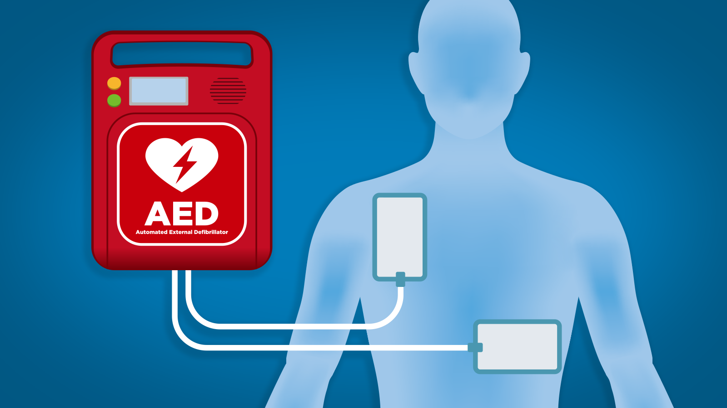
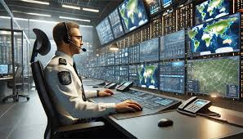
BUILD CLUB
Presents
ANVESHANA
2025-26
Team Name: TECH MAVERICKS
Theme: ARTIFICIAL INTELLIGENCE
Project Title: SAHAYAK: AI AED Dispatch & Guide

Slide 2
TEAM MEMBERS
NAME | ROLL NO
FAIZAN AHMED | 20221CSE0021
ZOYA ALAM | 20211CSE0242
POONACHA TC | 20231ECE0090
DEEPTHI BH | 20231CBD0031

Slide 3
PROBLEM STATEMENT
The Crisis: Sudden Cardiac Arrest (SCA) is a leading cause of death, with survival rates in India below 10%. Every minute without help drastically reduces the chance of survival.
The "Broken Chain of Survival" in India:
Delayed Response: Ambulances take too long to reach remote areas.
Lack of Action: Untrained bystanders hesitate to act.
Poor AED Management: Public AEDs are often unmanaged, hard to locate, and may not be operational when needed most.

Slide 4
PROPOSED SOLUTION
The SAHAYAK Ecosystem: An intelligent platform to manage a fleet of smart AEDs and accelerate emergency response.
Core Components:
A Smart AED Fleet + AI Predictive Maintenance Model : Each device is tracked for location, status, and battery health in real-time and also ai based maintenance
An Intelligent Dispatch Dashboard: A central command center for health administrators to monitor the entire network.
AI Voice: CPR & AED Guide: A calm AI voice provides interactive, patient-specific CPR and AED instructions in multilingual to guide any bystander through a rescue.
The Vision: To connect the incident, the nearest life-saving device, and the first responder in seconds, not minutes.

Slide 5
TECHNICAL APPROACH
System Architecture: A modern, scalable web application built for real-time data management.
Technology Stack:
Frontend: Next.js & React (for a fast, responsive user interface).
AI Engine: Google's Genkit (for creating powerful, tool-using AI flows).
Data: Client-side state management for a dynamic dashboard.
AI-Dispatch Workflow: Incident Report -> Genkit AI Structures Data -> AI Tool Finds Nearest AED -> Automated Dispatch & Alert -> AI Voice: CPR & AED Guide -> Incident Report

Slide 6
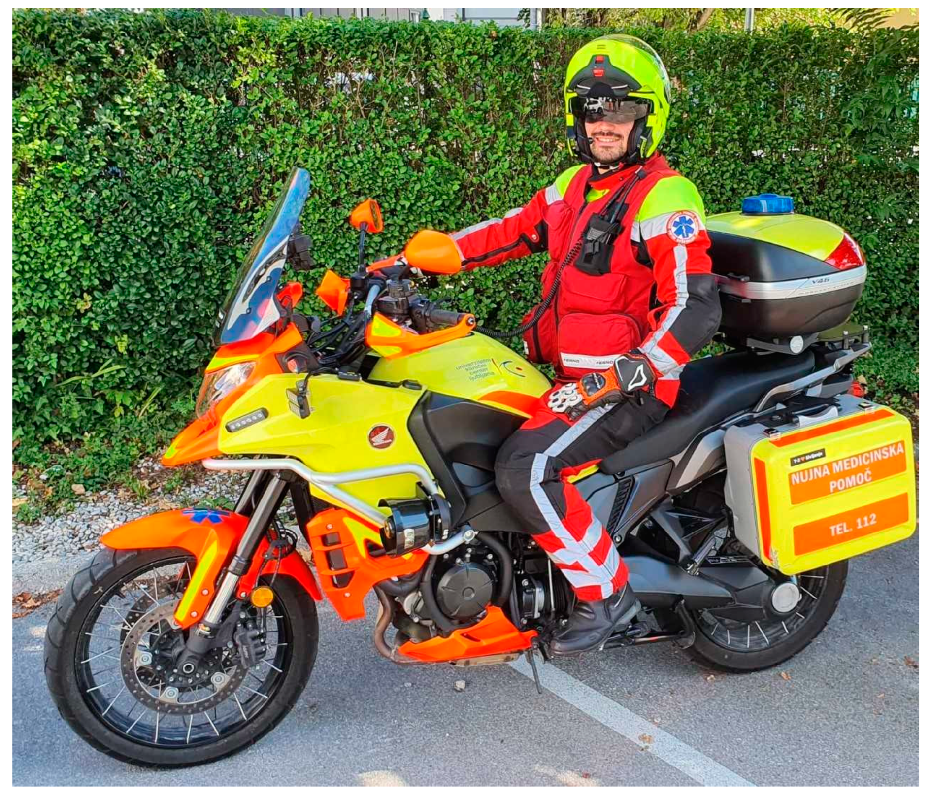
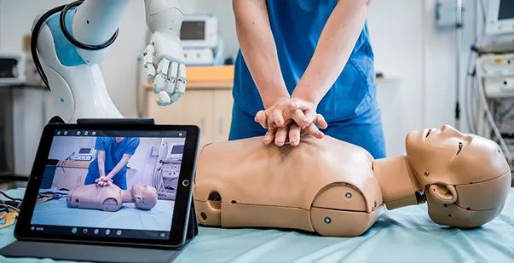
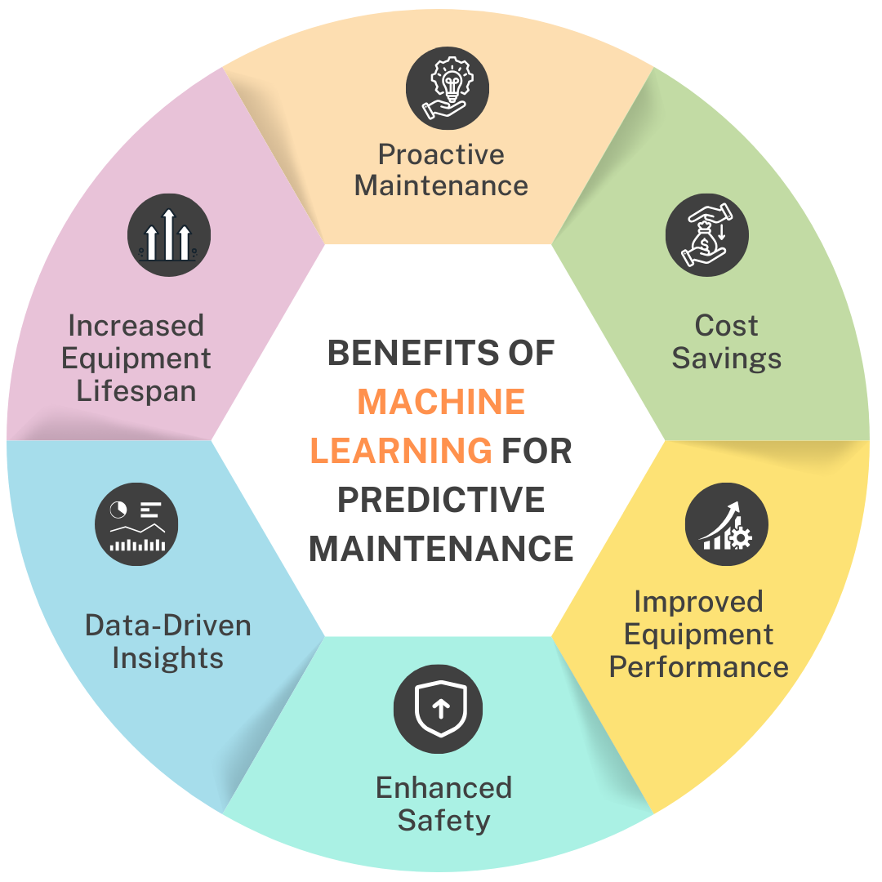
NOVELTY
AI-Powered Rapid Dispatch: Unlike static systems, SAHAYAK uses AI to instantly analyze an incident report and identify the single best AED for the job, reducing human error and dispatch time.
AI Voice & Audio CPR and AED Guides: Overcomes rescuer panic with clear, interactive, and localized (multilingual lang) audio instructions. The system provides tailored guides for different patient scenarios (e.g., male vs. female) to ensure correct AED pad placement on bare skin.
Post-Incident Intelligence: The platform's AI generates concise summaries, provides "AI Doctor's Analysis" of ECG data, and delivers "AI Eyes" CPR quality feedback, offering invaluable insights for medical review and training.
Predictive Maintenance: The system moves beyond simple battery alerts. It analyzes usage patterns and device logs to predict potential failures before they happen, ensuring maximum fleet readiness.

Slide 7
PROTOTYPE

Slide 8
IMPACT AND BENEFITS
For Patients & Communities
Increases Survival Rates: SAHAYAK saves lives by cutting response times and guiding rescuers.
Empowers Bystanders: It turns any citizen into a confident first responder.
For Health Administrators
Boosts Operational Efficiency: The dashboard provides a single, time-saving view of the entire AED fleet.
Ensures Fleet Readiness: Predictive AI fixes problems before they can cost a life.
For Student Innovators
Fosters Future Innovators: Mentees gained invaluable hands-on experience in AI and product design.
Bridges the Knowledge Gap: The project created a powerful collaboration between engineering and school students.

Slide 9
FUTURE SCOPE
Clinical Validation: Partner with medical professionals to validate all AI-driven analysis and instructional content against the latest AHA/ILCOR guidelines.
Regulatory Compliance: Begin the process of navigating the approval pathway for "Software as a Medical Device" (SaMD).
Hardware Integration: Develop and integrate physical AED prototypes for real-time data streaming into the platform.
Public-Facing App: Create a simplified mobile app for citizen responders to locate the nearest public AED in an emergency.

Slide 10
Thank you

